Slide 1
Set Up
Ubuntu and ROS Noetic Installation

Slide 2
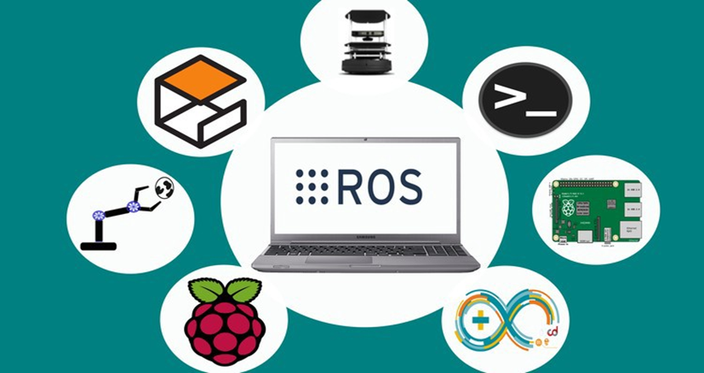
Introduction
For this course ROS Noetic will be used.
ROS Requires the installation of Ubuntu
MCR2 offers different alternatives
Install Ubuntu as Native OS
Install Ubuntu as Dual Boot
Install MCR2 Virtual Machine (VM) with preinstalled ROS.
Install WSL

Slide 3
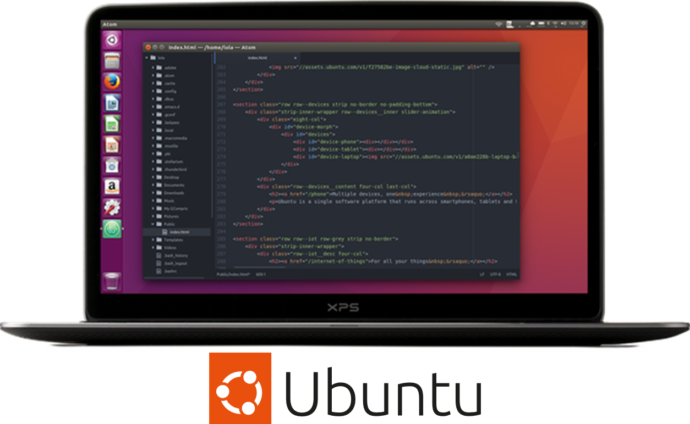
Getting Started with ROS
What do we need to start working?
Minimum Requirements*:
Processor: i5 or higher
RAM: 8 GB or higher
Storage: 20 Gb
Graphics: Dedicated GPU
*This requirements are the minimum for the activities designed.

Slide 4
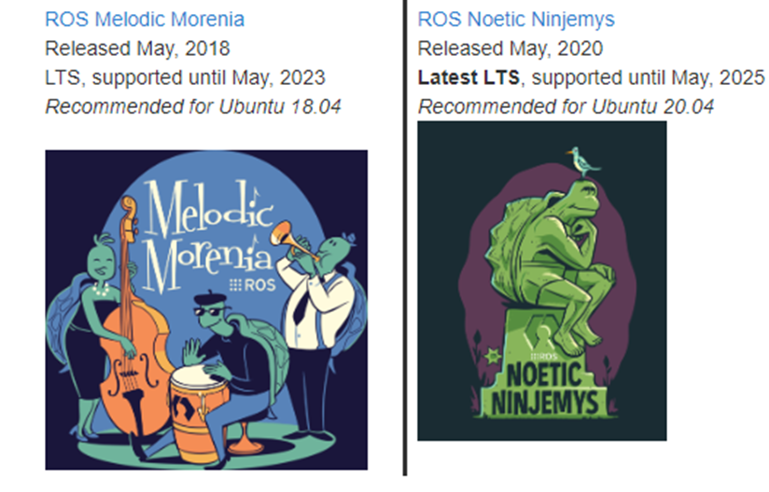
Getting Started with ROS
A new version of ROS is released with each Linux distribution. We will use ROS Noetic in this course (released with Ubuntu 20.04).
Currently, another version of ROS called ROS2 is available, Ubuntu 22.04.
ROS 1 and ROS2 are development platforms.
For this course ROS1 will be used since the community is well established and most of the companies that use ROS have not migrated to ROS2 (in development).

Slide 5
Ubuntu 20.04
Installation

Slide 6
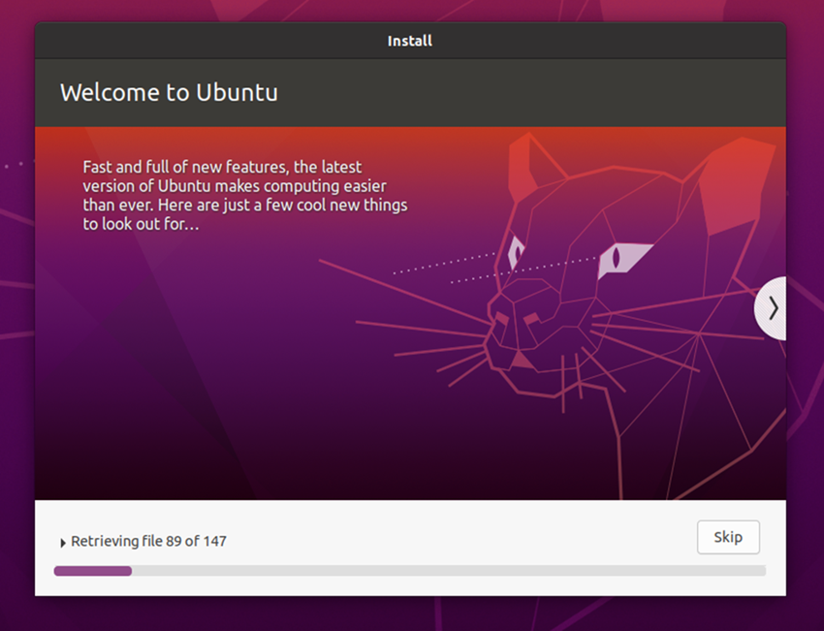
Installing Ubuntu
Installing Ubuntu
The recommended way of installing Ubuntu for robotics is as the main operating system or by dual booting it alongside the default Windows or Mac OS.
It can also run on a virtual machine, but this will limit features, and the performance speed could be affected.
If you are installing Ubuntu natively or dual-boot please go to the section “ROS:Noetic Installation” once the Ubuntu installation is complete.

Slide 7
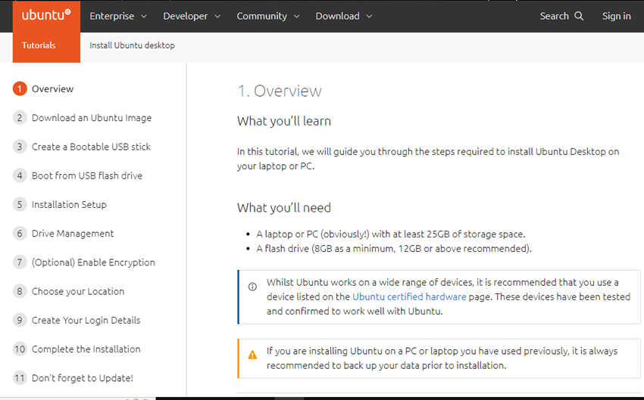
Installing Ubuntu: Native
Quick Installation Guide Ubuntu as Main OS
Follow the tutorial on the official ubuntu website. Download the ubuntu 20.04 image here.
On the left side of the webpage, all the steps for the installation are detailed.
Once you click on each step, the installation details are described in the right panel.
PROS: Easy installation, access in full to hardware.
“CONS”: Not possible if you need windows installed on the same machine.

Slide 8
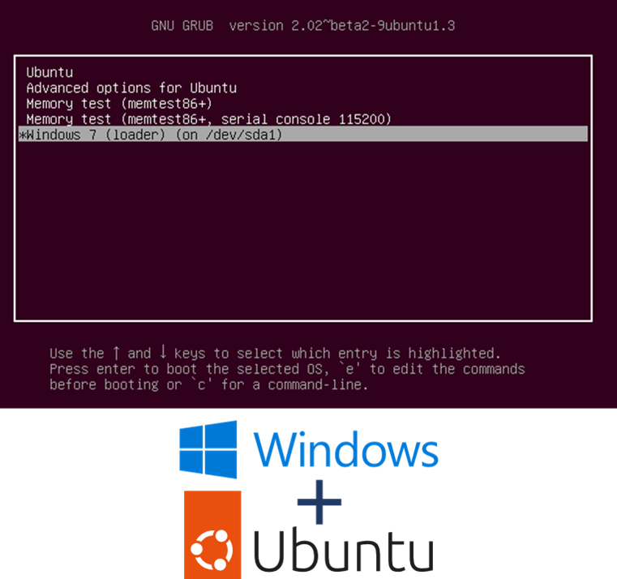
Installing Ubuntu: Dual Boot
Dual Boot Installation
This installation requires preparing the computer first. This may vary depending on the computer brand, but the main steps are:
Prepare the USB as the website indicates. (Step 1-4)
You may need to modify some parameters from the BIOS configuration.
Depending on how many partitions or how full the disc is, you may want to defrag and partition your hard drive using Windows. More info here.
Change the booting option from the computer and keep following the steps on the website.
PROS: Relatively easy install, access in full to hardware .
CONS: a problem if you must use windows and don’t have another machine.

Slide 9
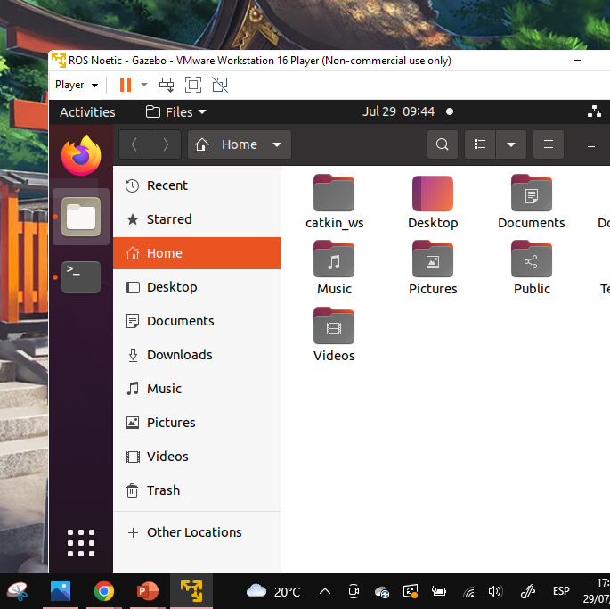
Installing Ubuntu: Virtual Machine (VM)
Virtual Machine vs. Standard Installation
A Virtual Machine (VM or guest OS) is an emulated Operated System done by software (Virtual Box and VMware most popular) installed in the main OS (host OS).
This could be helpful as a starting point (or a last resort), but it has some cons:
The host OS and guest OS share the same resources, affecting both operations (especially for heavy simulations).
VM requires drivers to access the peripherical (USB, Serial), which could be not supported or not fully working.
The VM cannot have the same network as the host (main operative system), which would be a problem for ROS projects that require multiple devices that communicate with each other.

Slide 10
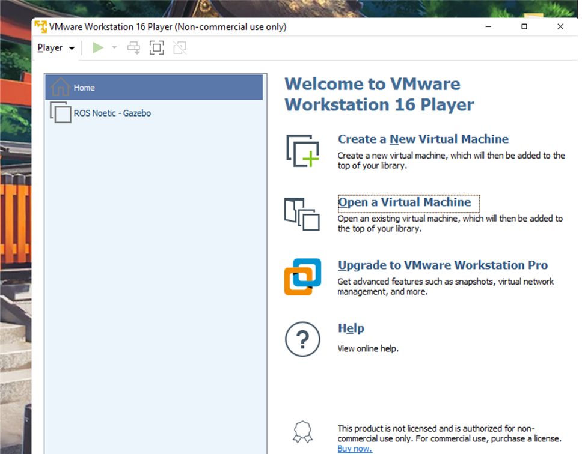
MCR2 Virtual Machine Installation
MCR2 has prepared a ready to go Virtual Machine, you do not require to install ROS.
Download and unzip the files:
VMware software executable
Preinstalled VM zip file
(NOTE: This is a long file ( ~ 6GB).)
Install the VMware software.
Open the software, finish the setup, and license.
NOTE: Select personal “non-commercial” use
Click on “Open Virtual Machine” and open the the file you just unzipped (Ubuntu_ROS) and select the file “Ubuntu_ROS” (you only must do this once). The virtual machine will start to be set up.
NOTE: Choose the option “I copied it”
The virtual machine should start up with Ubuntu and ROS installed!
USER: Student
PASSWORD: admin

Slide 11
ROS: Noetic
Installation

Slide 12
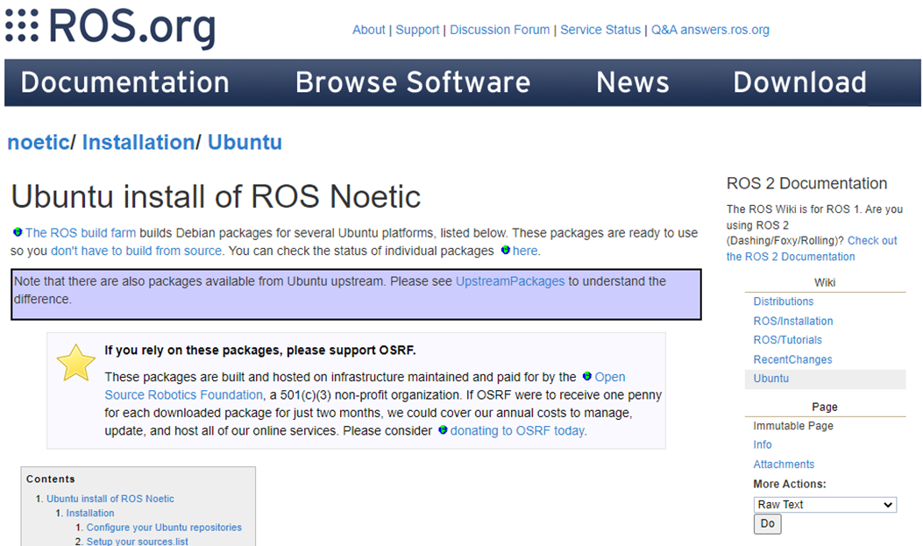
Quick installation guide for ROS
ROS Installation
Follow the tutorial on the official ROS website.
The ROS installation is done using the terminal.
In section 1.4, use the command for installing Desktop-Full Install.
This will install Gazebo too.
The following package is needed for this unit:
$ sudo apt-get install ros-noetic-ros-control ros-noetic-ros-controllers

Slide 13
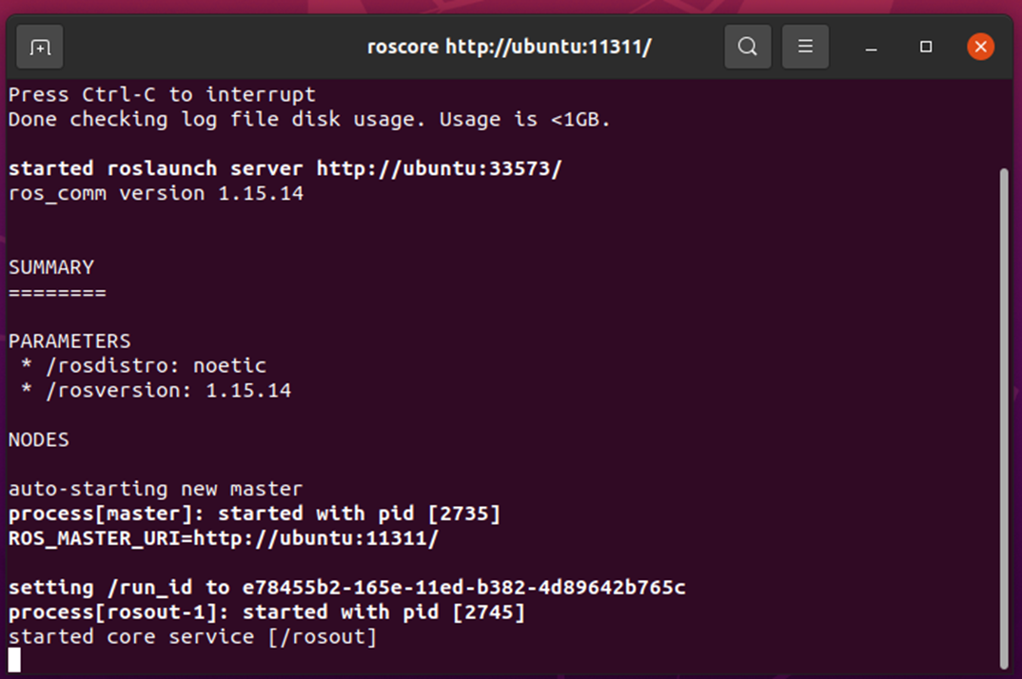
ROS is installed
How do I know it is working correctly?
If you finished the installation and everything went smoothly.
Then, try the following command to start ROS:
roscore
If the terminal displays a similar output to this image in the slide: Congratulations, you have Ubuntu and ROS running!

